Slide 1
Risk and Asset Allocation
Attilio Meucci
3.1.3~3.2
0353915 王偉丞

Slide 2

3.1.3 Derivatives
We pursue the quest for invariance in the derivatives market
Focus on vanilla European options
將歐式選擇權在時間t時的價格訂為Dt
h is a specific pricing function and Vt is the price at time t of a set of market variables.

Slide 3




European options
A European call option with strike K and expiry date E on an underlying whose price at the generic time t we denote as Ut is a security whose price at time t≦E :
換成 的形式 :
The payoff of an option is its value at expiry.

Slide 4
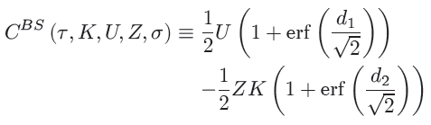
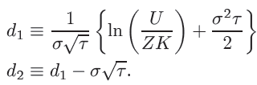


Black-Scholes formula
expressed in terms of the error function
$Φ\left(x\right)=\frac{1}{\sqrt{2π}}\int_{−∞}^{x}{exp\left(−\frac{t^{2}}{2}\right)}ⅆt$
$\operatorname{erf}\left(x\right)=\frac{2}{\sqrt{π}}\int_{0}^{x}{exp\left(−t^{2}\right)}ⅆt$

Slide 5


European options
A European put option with strike K and expiry date E on an underlying whose price at the generic time t we denote as Ut is a security whose price at time t≦E
Payoff of the put option :
因為在前面兩個章節 我們已經知道了價格變數中標的物(Ut) 和債券(Zt) 的invariants，所以我們只剩下探討隱含波動中的invariants

Slide 6
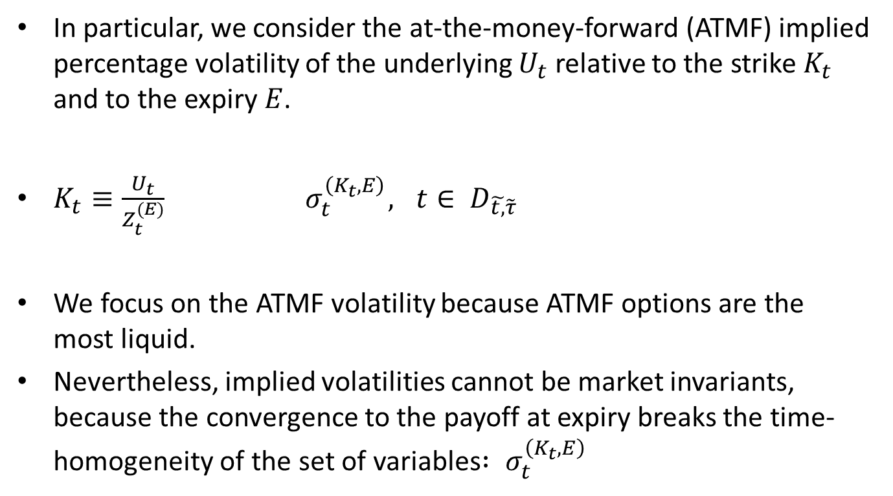
ATMF implied percentage volatility
In particular, we consider the at-the-money-forward (ATMF) implied percentage volatility of the underlying $U_{t}$ relative to the strike $K_{t}$ and to the expiry $E$.
$K_{t}≡\frac{U_{t}}{Z_{t}^{(E)}}{ σ}_{t}^{\left(K_{t},E\right)}, t∈ D_{\tilde{t,}\tilde{τ}}$
We focus on the ATMF volatility because ATMF options are the most liquid.
Nevertheless, implied volatilities cannot be market invariants, because the convergence to the payoff at expiry breaks the time-homogeneity of the set of variables${ : σ}_{t}^{\left(K_{t},E\right)}$

Slide 7

Find invariants
Therefore we consider the set of implied percentage
volatilities with the same time v to expiry
${ σ}_{t}^{\left(K_{t},t+v\right)}, t∈ D_{\tilde{t,}\tilde{τ}}$
${ σ}_{t}^{\left(K_{t},t+v\right)}≈\sqrt{\frac{2π}{v}}\frac{C_{t}^{\left(K_{t},t+v\right)}}{U_{t}}$

Slide 8
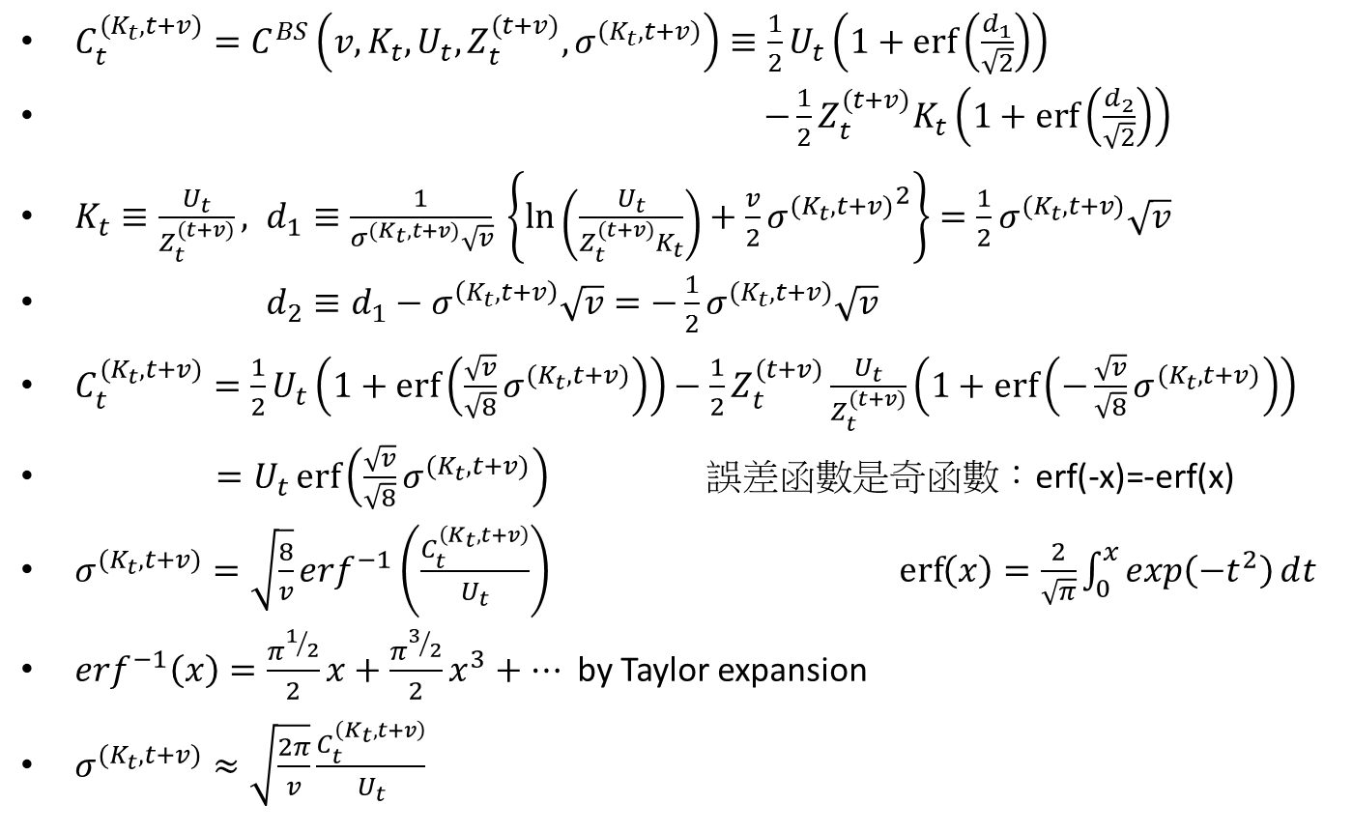

Proof${ : σ}_{t}^{\left(K_{t},t+v\right)}≈\sqrt{\frac{2π}{v}}\frac{C_{t}^{\left(K_{t},t+v\right)}}{U_{t}}$
$C_{t}^{(K_{t},t+v)}=C^{BS}\left(v,K_{t},U_{t},Z_{t}^{(t+v)},σ^{(K_{t},t+v)}\right)≡\frac{1}{2}U_{t}\left(1+\operatorname{erf}\left(\frac{d_{1}}{\sqrt{2}}\right)\right)$
$−\frac{1}{2}Z_{t}^{(t+v)}K_{t}\left(1+\operatorname{erf}\left(\frac{d_{2}}{\sqrt{2}}\right)\right)$
$K_{t}≡\frac{U_{t}}{Z_{t}^{(t+v)}}, d_{1}≡\frac{1}{σ^{(K_{t},t+v)}\sqrt{v}} \left\{\ln\left(\frac{U_{t}}{Z_{t}^{(t+v)}K_{t}}\right)+\frac{v}{2}{σ^{(K_{t},t+v)}}^{2}\right\}=\frac{1}{2}σ^{(K_{t},t+v)}\sqrt{v}$
$d_{2}≡d_{1}−σ^{\left(K_{t},t+v\right)}\sqrt{v}=−\frac{1}{2}σ^{(K_{t},t+v)}\sqrt{v}$
$C_{t}^{(K_{t},t+v)}=\frac{1}{2}U_{t}\left(1+\operatorname{erf}\left(\frac{\sqrt{v}}{\sqrt{8}}σ^{(K_{t},t+v)}\right)\right)−\frac{1}{2}Z_{t}^{(t+v)}\frac{U_{t}}{Z_{t}^{(t+v)}}\left(1+\operatorname{erf}\left(−\frac{\sqrt{v}}{\sqrt{8}}σ^{(K_{t},t+v)}\right)\right)$
$=U_{t}\operatorname{erf}\left(\frac{\sqrt{v}}{\sqrt{8}}σ^{(K_{t},t+v)}\right)$ 誤差函數是奇函數：erf(-x)=-erf(x)
$σ^{(K_{t},t+v)}=\sqrt{\frac{8}{v}}erf^{−1}\left(\frac{C_{t}^{\left(K_{t},t+v\right)}}{U_{t}}\right)$ $\operatorname{erf}\left(x\right)=\frac{2}{\sqrt{π}}\int_{0}^{x}{exp\left(−t^{2}\right)}ⅆt$
$erf^{−1}\left(x\right)=\frac{π^{1/2}}{2}x+\frac{π^{3/2}}{2}x^{3}+…$ by Taylor expansion
$σ^{(K_{t},t+v)}≈\sqrt{\frac{2π}{v}}\frac{C_{t}^{\left(K_{t},t+v\right)}}{U_{t}}$

Slide 9
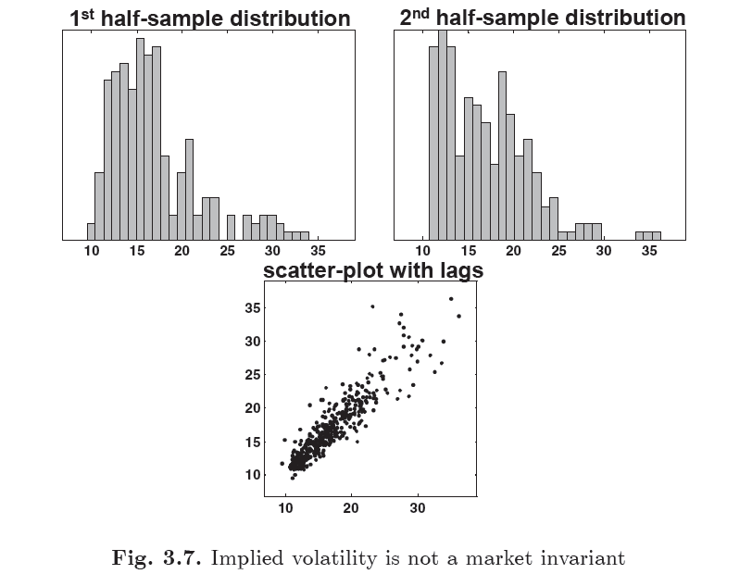
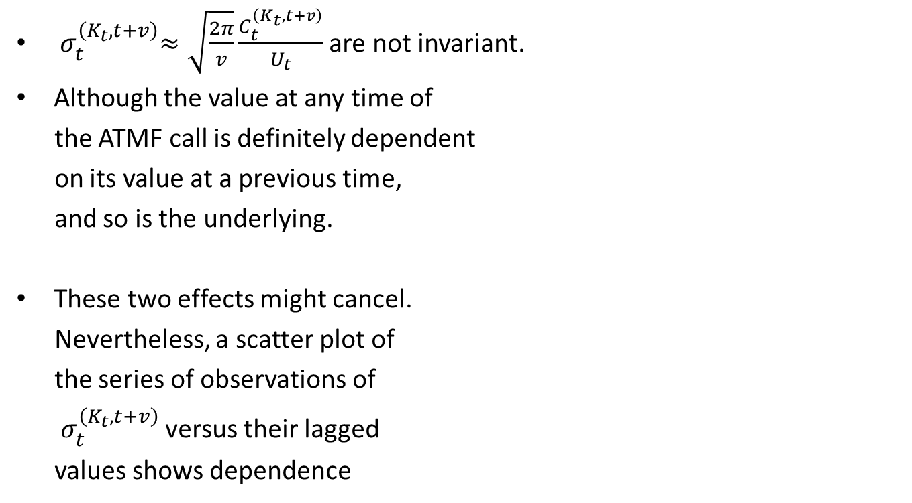
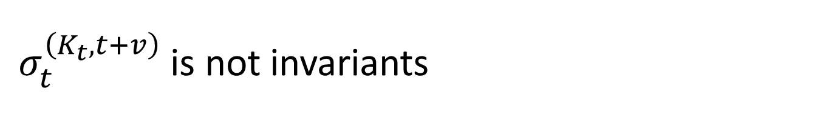
${ σ}_{t}^{\left(K_{t},t+v\right)}$ is not invariants
${ σ}_{t}^{\left(K_{t},t+v\right)}≈\sqrt{\frac{2π}{v}}\frac{C_{t}^{\left(K_{t},t+v\right)}}{U_{t}}$ are not invariant.
Although the value at any time of
the ATMF call is definitely dependent
on its value at a previous time,
and so is the underlying.
These two effects might cancel.
Nevertheless, a scatter plot of
the series of observations of
${ σ}_{t}^{\left(K_{t},t+v\right)}$ versus their lagged
values shows dependence

Slide 10
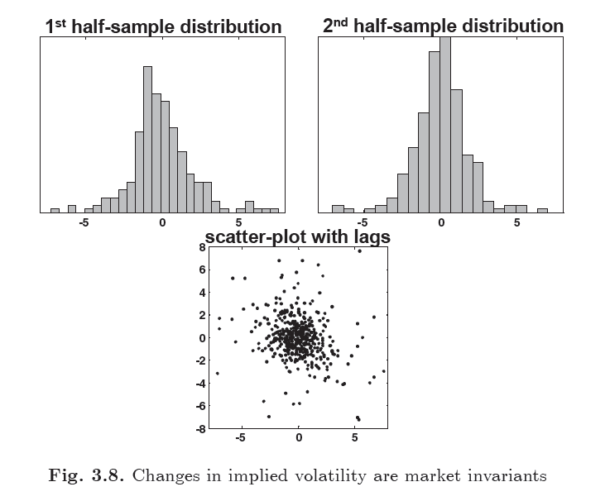
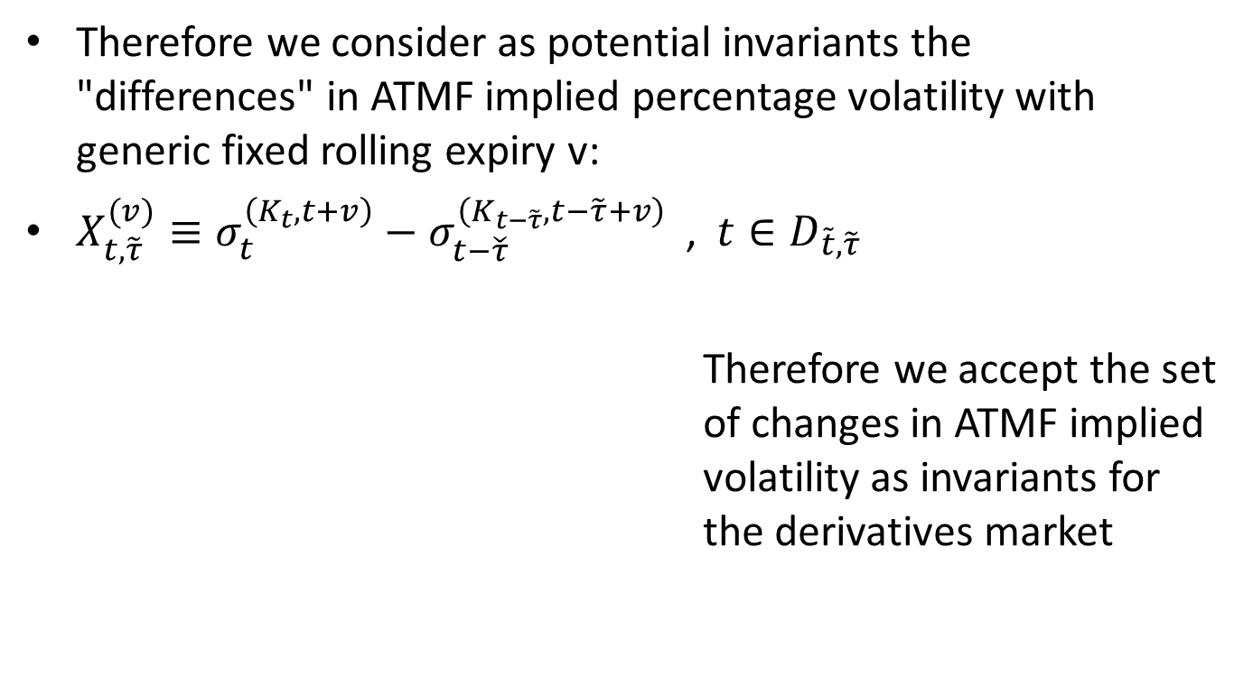
Find invariants
Therefore we consider as potential invariants the "differences" in ATMF implied percentage volatility with generic fixed rolling expiry v:
$X_{t,\tilde{τ}}^{(v)}≡σ_{t}^{\left(K_{t},t+v\right)}−σ_{t−\check{τ}}^{\left(K_{t−\tilde{τ}},t−\tilde{τ}+v\right)}$ ,$t∈D_{\tilde{t},\tilde{τ}}$
Therefore we accept the set of changes in ATMF implied volatility as invariants for the derivatives market

Slide 11

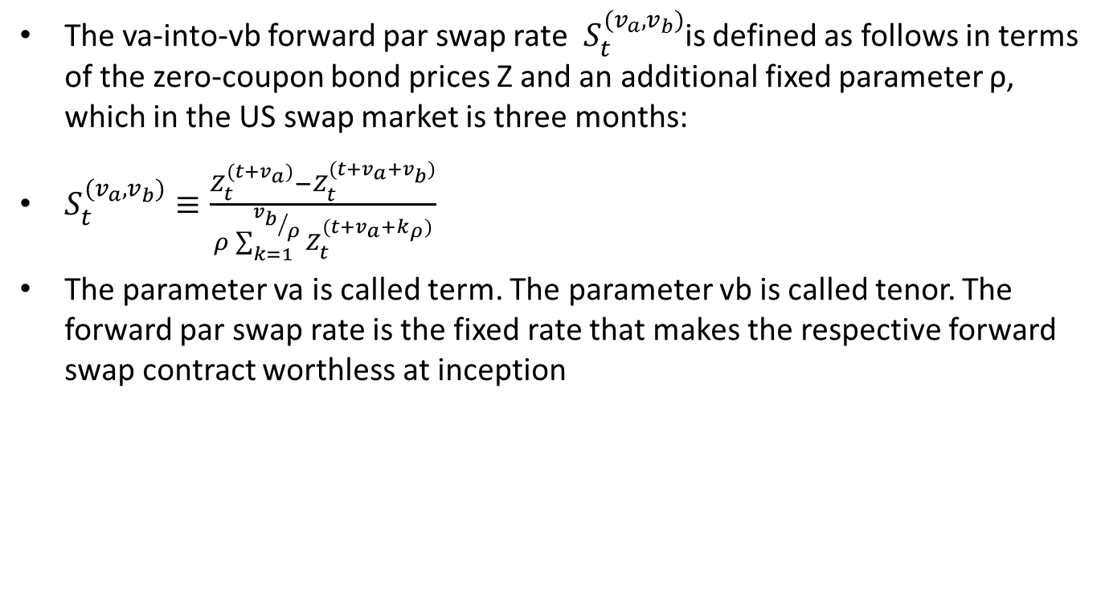

Find swap market invariants
The va-into-vb forward par swap rate $S_{t}^{(v_{a},v_{b})}$is defined as follows in terms of the zero-coupon bond prices Z and an additional fixed parameter ρ, which in the US swap market is three months:
$S_{t}^{(v_{a},v_{b})}≡\frac{Z_{t}^{(t+v_{a})}−Z_{t}^{(t+v_{a}+v_{b})}}{ρ\sum_{k=1}^{{v_{b}}/ρ}{Z_{t}^{(t+v_{a}+k_{ρ})}}}$
The parameter va is called term. The parameter vb is called tenor. The forward par swap rate is the fixed rate that makes the respective forward swap contract worthless at inception
ρ
ρ
ρ
t
$$t+v_{a}$$
$${t+v}_{a}+v_{b}$$

Slide 12
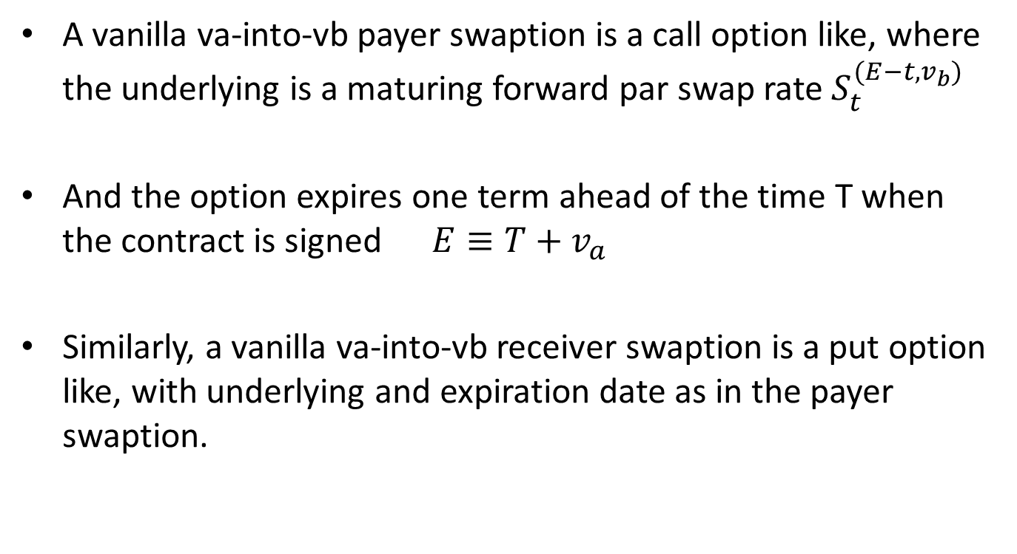
Swaption
A vanilla va-into-vb payer swaption is a call option like, where the underlying is a maturing forward par swap rate $S_{t}^{(E−t,v_{b})}$
And the option expires one term ahead of the time T when the contract is signed $E≡T+v_{a}$
Similarly, a vanilla va-into-vb receiver swaption is a put option like, with underlying and expiration date as in the payer swaption.

Slide 13
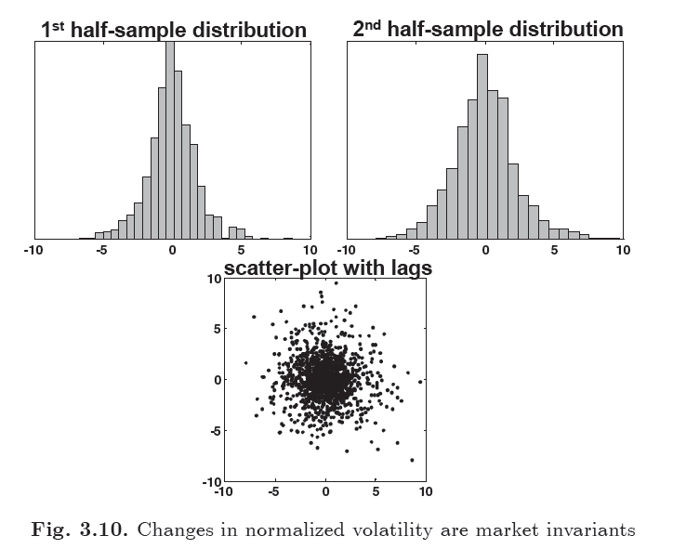
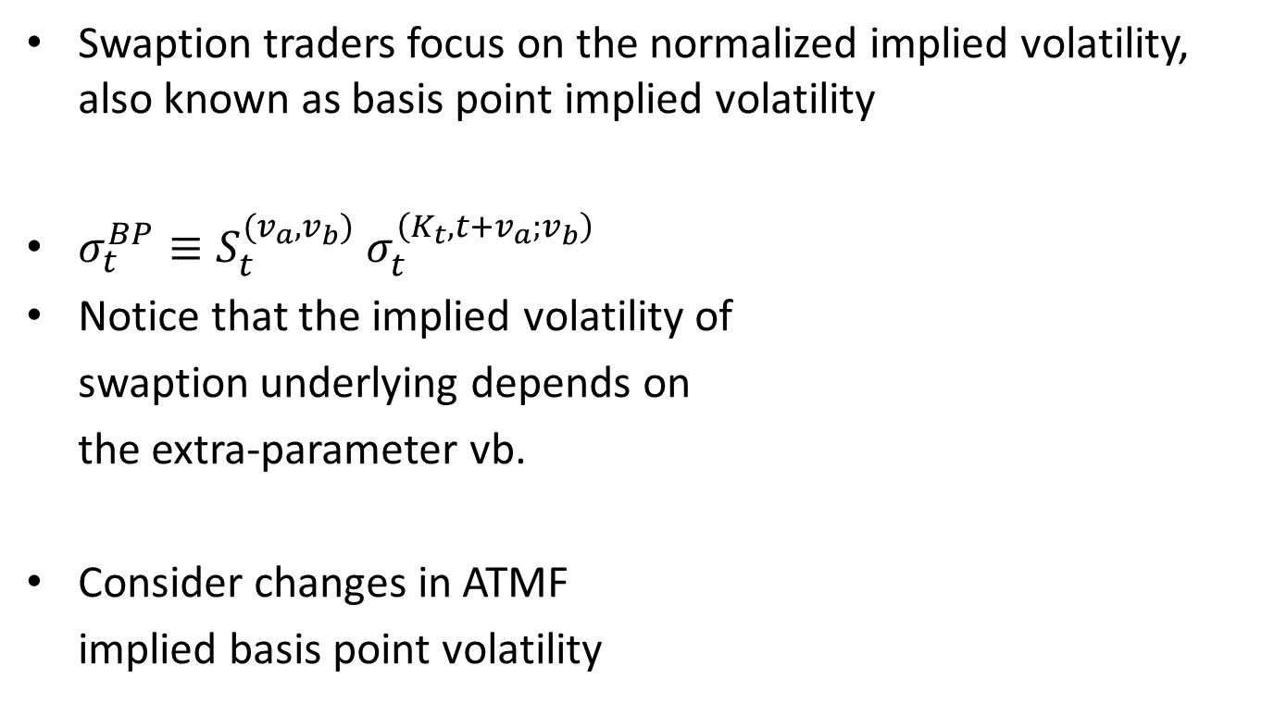
Invariants
Swaption traders focus on the normalized implied volatility, also known as basis point implied volatility
$σ_{t}^{BP}≡S_{t}^{(v_{a},v_{b})}$ $σ_{t}^{\left(K_{t},t+v_{a};v_{b}\right)}$
Notice that the implied volatility of
swaption underlying depends on
the extra-parameter vb.
Consider changes in ATMF
implied basis point volatility

Slide 14
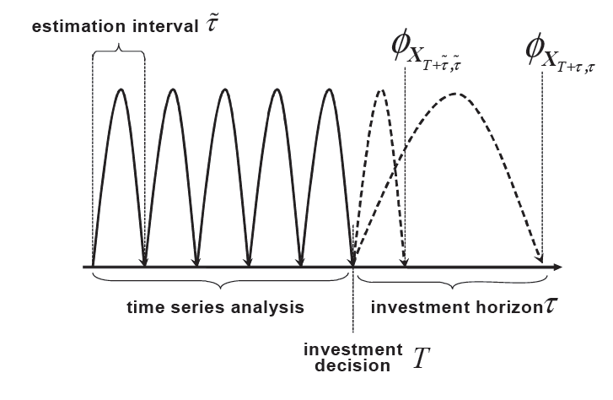

3.2 Projection of the invariants to the investment horizon
we project the distribution of the invariants, which we assume known, to the desired investment horizon
consider first an investment
horizon τ that is a multiple
of the estimation interval $\tilde{τ}$
The invariants are additive.
$X_{T+τ,τ}=X_{T+τ,\tilde{τ}}+X_{T+τ−\tilde{τ},\tilde{τ}}+…+X_{T+\tilde{τ},\tilde{τ}}$

Slide 15
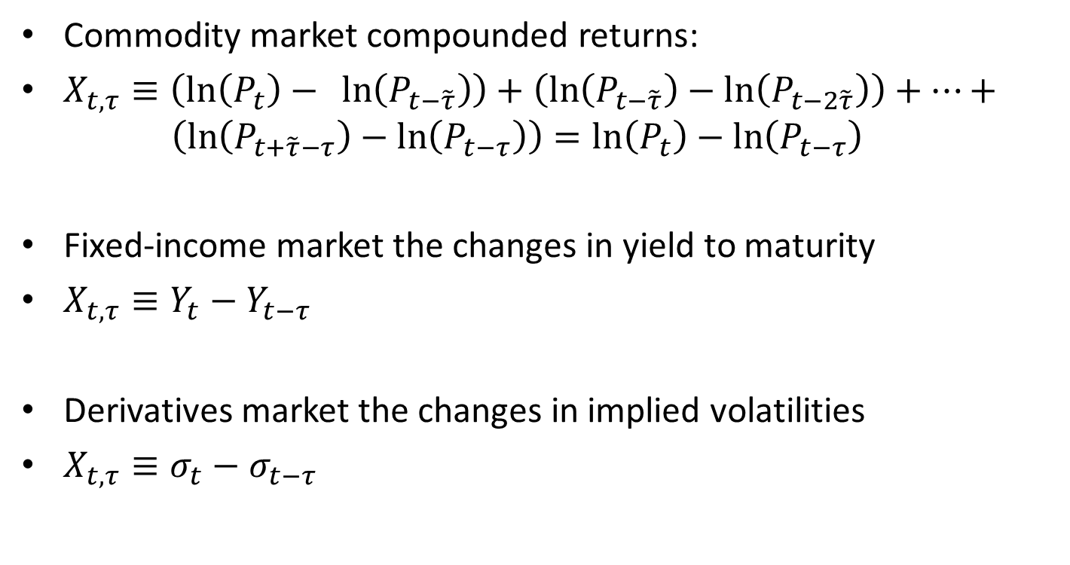
Poject invariants
Commodity market compounded returns:
$X_{t,τ}≡\left(\ln\left(P_{t}\right)− \ln\left(P_{t−\tilde{τ}}\right)\right)+\left(\ln\left(P_{t−\tilde{τ}}\right)−\ln\left(P_{t−2\tilde{τ}}\right)\right)+…+ \left(\ln\left(P_{t+\tilde{τ}−τ}\right)−\ln\left(P_{t−τ}\right)\right)=ln\left(P_{t}\right)−$ $\ln\left(P_{t−τ}\right)$
Fixed-income market the changes in yield to maturity
$X_{t,τ}≡Y_{t}−Y_{t−τ}$
Derivatives market the changes in implied volatilities
$X_{t,τ}≡σ_{t}−σ_{t−τ}$

Slide 16
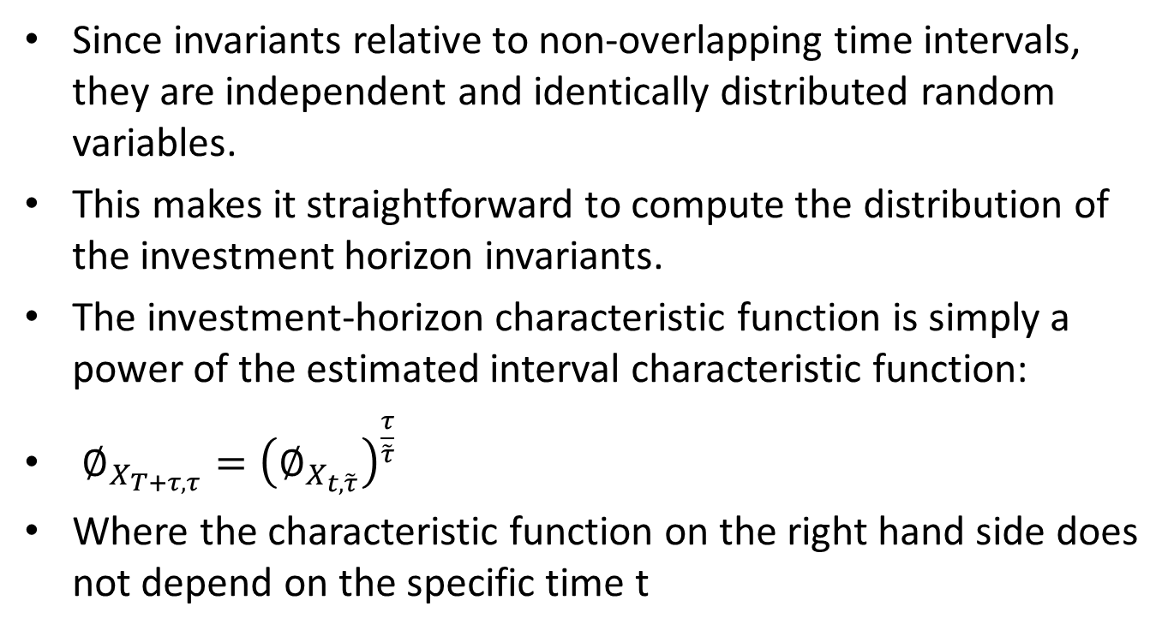
Poject characteristic function
Since invariants relative to non-overlapping time intervals, they are independent and identically distributed random variables.
This makes it straightforward to compute the distribution of the investment horizon invariants.
The investment-horizon characteristic function is simply a power of the estimated interval characteristic function:
$∅_{X_{T+τ,τ}}={\left(∅_{X_{t,\tilde{τ}}}\right)}^{\frac{τ}{\tilde{τ}}}$
Where the characteristic function on the right hand side does not depend on the specific time t

Slide 17
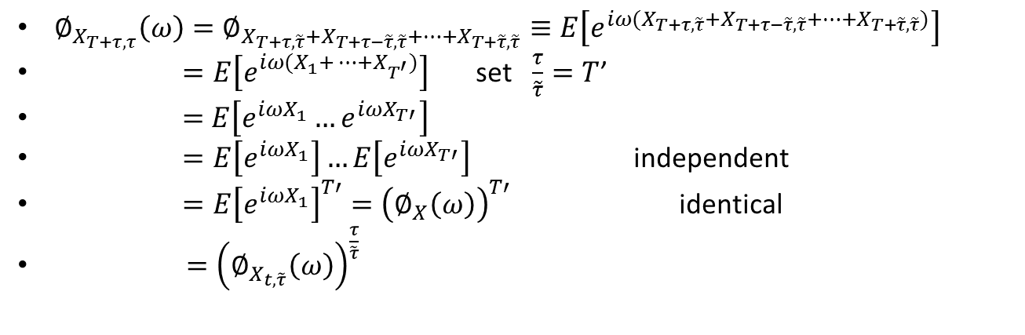

Proof
$∅_{X_{T+τ,τ}}\left(ω\right)=∅_{X_{T+τ,\tilde{τ}}+X_{T+τ−\tilde{τ},\tilde{τ}}+…+X_{T+\tilde{τ},\tilde{τ}}}≡E\left[e^{iω(X_{T+τ,\tilde{τ}}+X_{T+τ−\tilde{τ},\tilde{τ}}+…+X_{T+\tilde{τ},\tilde{τ}})}\right]$
$=E\left[e^{iω{(X}_{1}+…+X_{T^{′}})}\right]$ set $\frac{τ}{\tilde{τ}}=T$’
$=$ $E\left[e^{iωX_{1}}…e^{iωX_{T′}}\right]$
$=E\left[e^{iωX_{1}}\right]…E\left[e^{iωX_{T′}}\right]$ independent
$=E{\left[e^{iωX_{1}}\right]}^{T′}={\left(∅_{X}\left(ω\right)\right)}^{T′}$ identical
$={\left(∅_{X_{t,\tilde{τ}}}\left(ω\right)\right)}^{\frac{τ}{\tilde{τ}}}$
the investment-horizon pdf $f_{X_{T+τ,τ}}$or the estimation-interval pdf $f_{X_{t,\tilde{τ}}}$can be easily derived from this expression by means of the generic relations between the probability density function and the characteristic function.
$∅_{X}=F\left[f_{X}\right] , f_{X}=F^{−1}[∅_{X}]$
$∅_{X}\left(ω\right)=\int_{−∞}^{∞}{e^{iωx}f\left(x\right)dx }$
$f\left(x\right)=\frac{1}{2π}\int_{−∞}^{∞}{e^{−iωx}}∅_{X}\left(ω\right)dω$

Slide 18
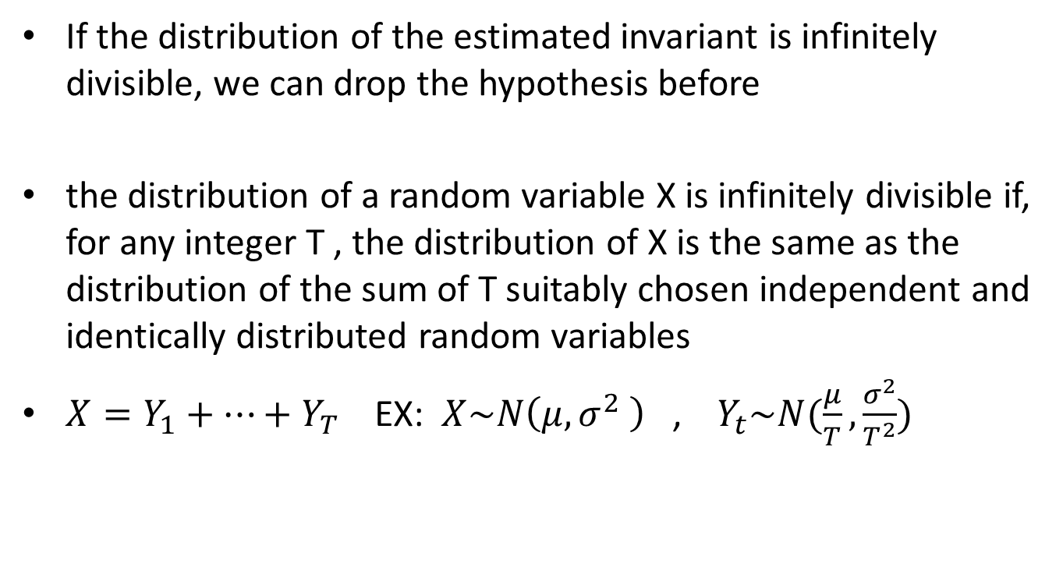
Infinitely divisible
If the distribution of the estimated invariant is infinitely divisible, we can drop the hypothesis before
the distribution of a random variable X is infinitely divisible if, for any integer T , the distribution of X is the same as the distribution of the sum of T suitably chosen independent and identically distributed random variables
$X=Y_{1}+…+Y_{T}$ EX: $X\sim N\left(μ,σ^{2} \right)$ , $Y_{t}\sim N(\frac{μ}{T},\frac{σ^{2}}{T^{2}})$

Slide 19


Relation
The projection formula implies a special relation between the projected moments and the estimated moments of the invariants
$E\left[X_{T+τ,τ}\right]=\frac{τ}{\tilde{τ}}E\left[X_{t,\tilde{τ}}\right]$
$Cov\left\{X_{T+τ,τ}\right\}=\frac{τ}{\tilde{τ}}Cov\left\{X_{t,\tilde{τ}}\right\}$
Proof: $∅_{X_{T+τ,τ}}(ω)={\left(∅_{X_{t,\tilde{τ}}}(ω)\right)}^{\frac{τ}{\tilde{τ}}}$
$$\frac{∂∅_{X_{T+τ,τ}}(ω)}{∂ω}= \frac{∂{(∅_{X_{t,\tilde{τ}}}(ω))}^{\frac{τ}{\tilde{τ}}}}{∂ω}$$
$$=\frac{τ}{\tilde{τ}}{(∅_{X_{t,\tilde{τ}}}(ω))}^{\frac{τ}{\tilde{τ}}−1}\frac{∂∅_{X_{t,\tilde{τ}}}(ω)}{∂ω}$$
Since $∅_{X}\left(0\right)≡E\left[e^{iX0}\right]=1$
And $E\left[X\right]=−i\frac{∂∅_{X}(0)}{∂ω}$
$$E\left[X_{T+τ,τ}\right]=−i\frac{∂∅_{X_{T+τ,τ}}\left(0\right)}{∂ω}=−i\frac{τ}{\tilde{τ}}∗1∗\frac{∂∅_{X_{t,\tilde{τ}}}\left(0\right)}{∂ω}$$
$$=\frac{τ}{\tilde{τ}}\left(−i\frac{∂∅_{X_{t,\tilde{τ}}}\left(0\right)}{∂ω}\right)=\frac{τ}{\tilde{τ}}E\left[X_{t,\tilde{τ}}\right]$$

Slide 20
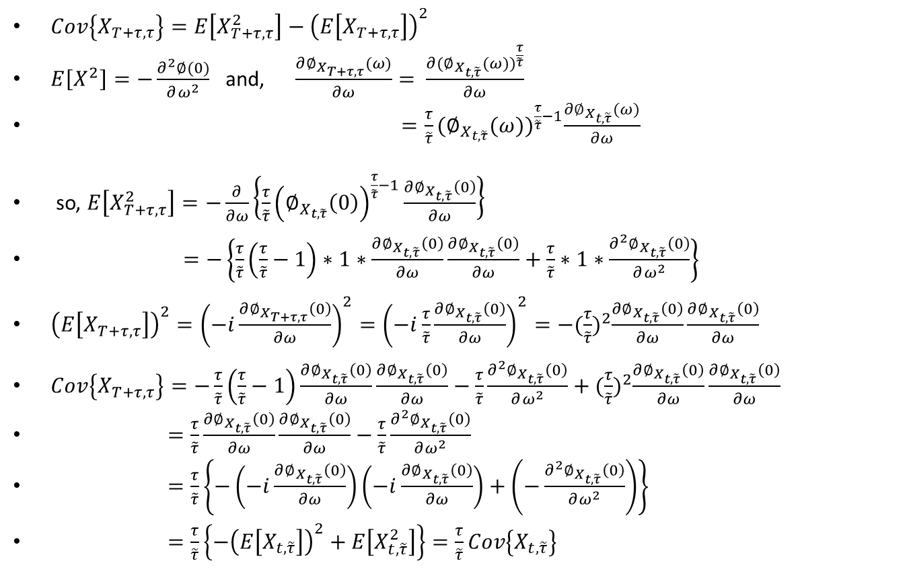

Proof $Cov\left\{X_{T+τ,τ}\right\}=\frac{τ}{\tilde{τ}}Cov\left\{X_{t,\tilde{τ}}\right\}$
$Cov\left\{X_{T+τ,τ}\right\}=E\left[X_{T+τ,τ}^{2}\right]−{\left(E\left[X_{T+τ,τ}\right]\right)}^{2}$
$E\left[X^{2}\right]=−\frac{∂^{2}∅(0)}{∂ω^{2}}$ and, $\frac{∂∅_{X_{T+τ,τ}}(ω)}{∂ω}= \frac{∂{(∅_{X_{t,\tilde{τ}}}(ω))}^{\frac{τ}{\tilde{τ}}}}{∂ω}$
$=\frac{τ}{\tilde{τ}}{(∅_{X_{t,\tilde{τ}}}(ω))}^{\frac{τ}{\tilde{τ}}−1}\frac{∂∅_{X_{t,\tilde{τ}}}(ω)}{∂ω}$
so, $E\left[X_{T+τ,τ}^{2}\right]=−\frac{∂}{∂ω}\left\{\frac{τ}{\tilde{τ}}{\left(∅_{X_{t,\tilde{τ}}}\left(0\right)\right)}^{\frac{τ}{\tilde{τ}}−1}\frac{∂∅_{X_{t,\tilde{τ}}}\left(0\right)}{∂ω}\right\}$
$=−\left\{\frac{τ}{\tilde{τ}}\left(\frac{τ}{\tilde{τ}}−1\right)∗1∗\frac{∂∅_{X_{t,\tilde{τ}}}\left(0\right)}{∂ω}\frac{∂∅_{X_{t,\tilde{τ}}}\left(0\right)}{∂ω}+\frac{τ}{\tilde{τ}}∗1∗\frac{∂^{2}∅_{X_{t,\tilde{τ}}}\left(0\right)}{∂ω^{2}}\right\}$
${\left(E\left[X_{T+τ,τ}\right]\right)}^{2}={\left(−i\frac{∂∅_{X_{T+τ,τ}}\left(0\right)}{∂ω}\right)}^{2}={\left(−i\frac{τ}{\tilde{τ}}\frac{∂∅_{X_{t,\tilde{τ}}}\left(0\right)}{∂ω}\right)}^{2}=−{(\frac{τ}{\tilde{τ}})}^{2}\frac{∂∅_{X_{t,\tilde{τ}}}\left(0\right)}{∂ω}\frac{∂∅_{X_{t,\tilde{τ}}}\left(0\right)}{∂ω}$
$Cov\left\{X_{T+τ,τ}\right\}=−\frac{τ}{\tilde{τ}}\left(\frac{τ}{\tilde{τ}}−1\right)\frac{∂∅_{X_{t,\tilde{τ}}}\left(0\right)}{∂ω}\frac{∂∅_{X_{t,\tilde{τ}}}\left(0\right)}{∂ω}−\frac{τ}{\tilde{τ}}\frac{∂^{2}∅_{X_{t,\tilde{τ}}}\left(0\right)}{∂ω^{2}}+{(\frac{τ}{\tilde{τ}})}^{2}\frac{∂∅_{X_{t,\tilde{τ}}}\left(0\right)}{∂ω}\frac{∂∅_{X_{t,\tilde{τ}}}\left(0\right)}{∂ω}$
$=\frac{τ}{\tilde{τ}}\frac{∂∅_{X_{t,\tilde{τ}}}\left(0\right)}{∂ω}\frac{∂∅_{X_{t,\tilde{τ}}}\left(0\right)}{∂ω}−\frac{τ}{\tilde{τ}}\frac{∂^{2}∅_{X_{t,\tilde{τ}}}\left(0\right)}{∂ω^{2}}$
$=\frac{τ}{\tilde{τ}}\left\{−\left(−i\frac{∂∅_{X_{t,\tilde{τ}}}\left(0\right)}{∂ω}\right)\left(−i\frac{∂∅_{X_{t,\tilde{τ}}}\left(0\right)}{∂ω}\right)+\left(−\frac{∂^{2}∅_{X_{t,\tilde{τ}}}\left(0\right)}{∂ω^{2}}\right)\right\}$
$=\frac{τ}{\tilde{τ}}\left\{−{\left(E\left[X_{t,\tilde{τ}}\right]\right)}^{2}+E\left[X_{t,\tilde{τ}}^{2}\right]\right\}=\frac{τ}{\tilde{τ}}Cov\left\{X_{t,\tilde{τ}}\right\}$

Slide 21
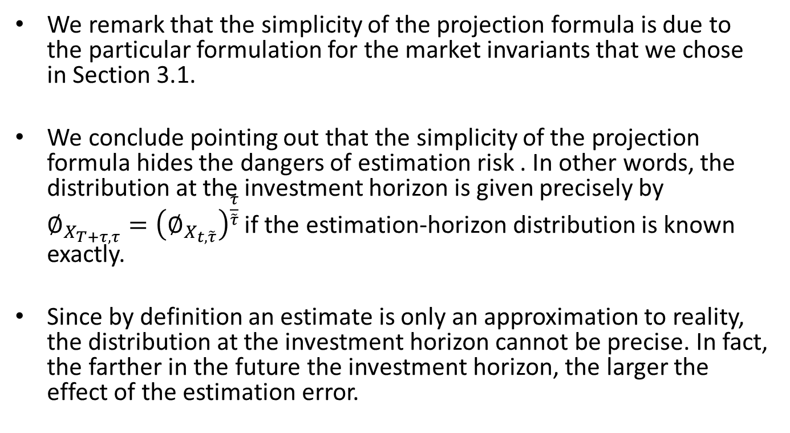
Concluding
We remark that the simplicity of the projection formula is due to the particular formulation for the market invariants that we chose in Section 3.1.
We conclude pointing out that the simplicity of the projection formula hides the dangers of estimation risk . In other words, the distribution at the investment horizon is given precisely by $∅_{X_{T+τ,τ}}={\left(∅_{X_{t,\tilde{τ}}}\right)}^{\frac{τ}{\tilde{τ}}}$ if the estimation-horizon distribution is known exactly.
Since by definition an estimate is only an approximation to reality, the distribution at the investment horizon cannot be precise. In fact, the farther in the future the investment horizon, the larger the effect of the estimation error.

